Slide 1
Chapter 7: Text Operations

Slide 2
Document Preprocessing
Lexical analysis of the text
Elimination of stopwords
Stemming
Selection of index terms
Construction of term categorization structures

Slide 3
Lexical Analysis of the Text
Word separators
  space
  digits
  hyphens
  punctuation marks
  the case of the letters

Slide 4
Elimination of Stopwords
A list of stopwords
  words that are too frequent among the documents
  articles, prepositions, conjunctions, etc.
Can reduce the size of the indexing structure considerably
Problem
  Search for “to be or not to be”?

Slide 5
Stemming
Example
  connect, connected, connecting, connection, connections
  effectiveness --> effective --> effect
  picnicking --> picnic
  king -\-> k
Removing strategies
  affix removal: intuitive, simple
  table lookup
  successor variety
  n-gram

Slide 6
Index Terms Selection
Motivation
  A sentence is usually composed of nouns, pronouns, articles, verbs, adjectives, adverbs, and connectives.
  Most of the semantics is carried by the noun words.
Identification of noun groups
  A noun group is a set of nouns whose syntactic distance in the text does not exceed a predefined threshold

Slide 7
Thesauri
Peter Roget, 1988
Example
  cowardly adj.
  Ignobly lacking in courage: cowardly turncoats
  Syns: chicken (slang), chicken-hearted, craven, dastardly, faint-hearted, gutless, lily-livered, pusillanimous, unmanly, yellow (slang), yellow-bellied (slang).
A controlled vocabulary for the indexing and searching

Slide 8
The Purpose of a Thesaurus
To provide a standard vocabulary for indexing and searching
To assist users with locating terms for proper query formulation
To provide classified hierarchies that allow the broadening and narrowing of the current query request

Slide 9
Thesaurus Term Relationships
BT: broader
NT: narrower
RT: non-hierarchical, but related

Slide 10
Document Clustering
The operation of grouping together similar (or related) documents in classes.
In this regard, document clustering is not really an operation on the text but and operation on the collection of documents.
Clustering methods are usually used in IR to transform the original query in an attempt to better represent the user information need.

Slide 11
Text Compression
Text compression is about finding ways to represent the text in fewer bits or bytes.
From the compressed version, the original text can be reconstructed.
Why Text Compression in IR?
A major obstacle for storing text in compressed form is the need for IR systems to access text randomly.
To access a given word in a compressed text, it is usually necessary to decode to entire text from the beginning until the desired word is reached.

Slide 12
Contd…
Besides the economy of space obtained by a compression method, there are other important characteristics to be considered such as compression and decompression speed.
In some situations, decompression speed is more important than compression speed.
For instance, this is the case with textual databases in which it is common to compress the text once and to read it many times from disk.

Slide 13
Contd…
There are two general approaches to text compression:
Statistical and Dictionary based.
Statistical methods rely on Generating good probability estimates (of appearance in the text) for each symbol.
The more accurate the estimates are, the better the compression obtained. A symbol here is usually a character, a text word, or a fixed number of characters.

Slide 14
Contd…
The set of all possible symbols in the text is called the alphabet.
The task of estimating the probability on each next symbol is called modeling.
A model is essentially a collection of probability distributions, one for each context in which a symbol can be coded.
Once these probabilities are available the symbols are converted into binary digits, a process called coding.

Slide 15
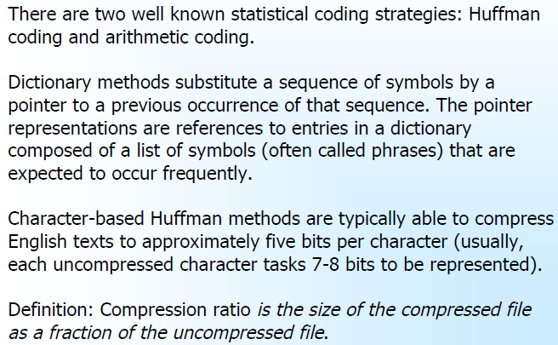
Contd…

Slide 16

Statistical Methods
In a statistical method, a probability is estimated for each symbol (the modeling task) and, based on this probability, a code is assigned to each symbol at a time (the coding task).
Shorter codes are assigned to the most likely symbols.
E is a lower bound on compression, measured in bits per symbol, Which applies to any coding method based on the probability distribution Pi .
The basic function of a model is to provide a probability assignment for the next symbol to be coded.

Slide 17
Compression models can be adaptive, static, or semi-static.
Adaptive models start with no information about the text and progressively learn about its statistical distribution as the compression process goes on.
Static models assume an average distribution for all input texts. The modeling phase is done only once for all texts to be coded In the future.

Slide 18
Semi-static models do not assume any distribution on the data, But learn it in a first pass.
In a second pass, they compress the data by using a fixed code derived from the distribution learned from the first pass.
Semi-static models have a crucial advantage in IR contexts: since the same codes are used at every point in the compressed file, direct access is possible.

Slide 19
Word-based models take words instead of characters as symbols. Usually, a word is a contiguous string of characters in the set {A..Z, a..z} separated by other characters not in the set {A..Z, a..z}.
There are many good reasons to use word-based models in an IR context.

Slide 20
First, much better compression rates are achieved by taking words as symbols because words carry a lot of meaning in natural languages and, as a result, their distribution is much more related to the semantic structure of the text than the individual letters.
Second, words are the atoms on which most information retrieval systems are built.
Third, the word frequencies are also useful in answering queries involving combinations of words.

Slide 21
Huffman coding
One of the best known compression methods.
Compression is achieved by assigning shorter codes to more frequent symbols.
Decompression uniqueness is guaranteed because no code is a prefix of another.

Slide 22
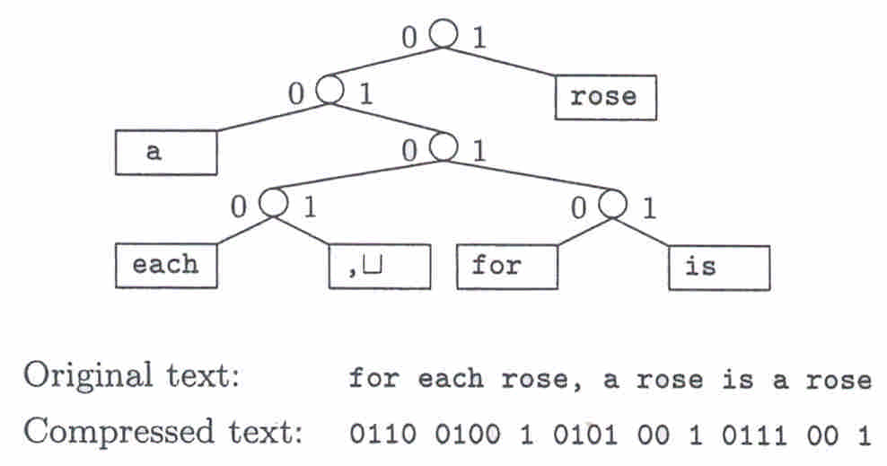
Example

Slide 23
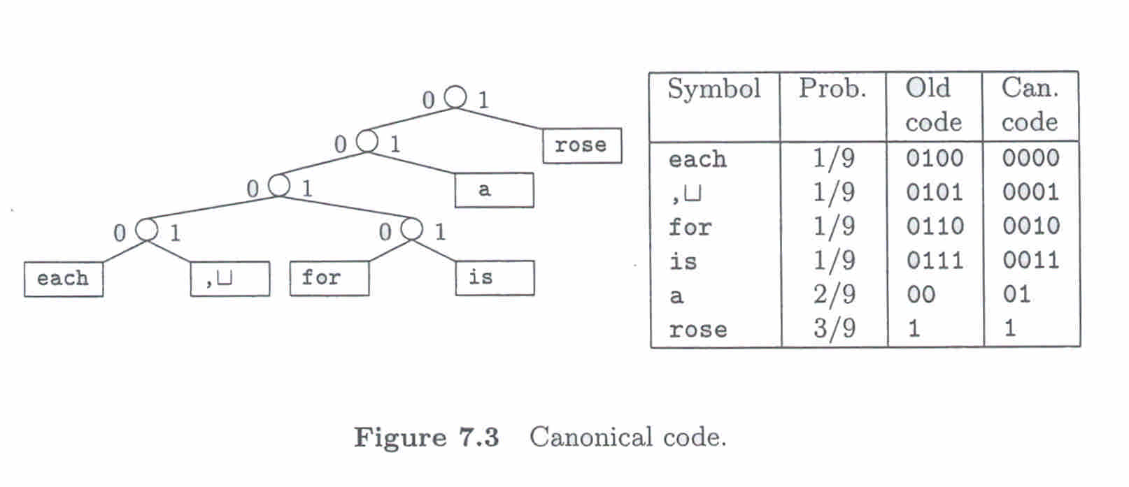
Contd…
A Huffman tree is canonical when the height of the left subtree of any node in never smaller than that of the right subtree, and all leaves are in increasing order of probabilities from left to right.
One of the properties of canonical codes is that the set of codes having the same length are the binary representations of consecutive integers.

Slide 24
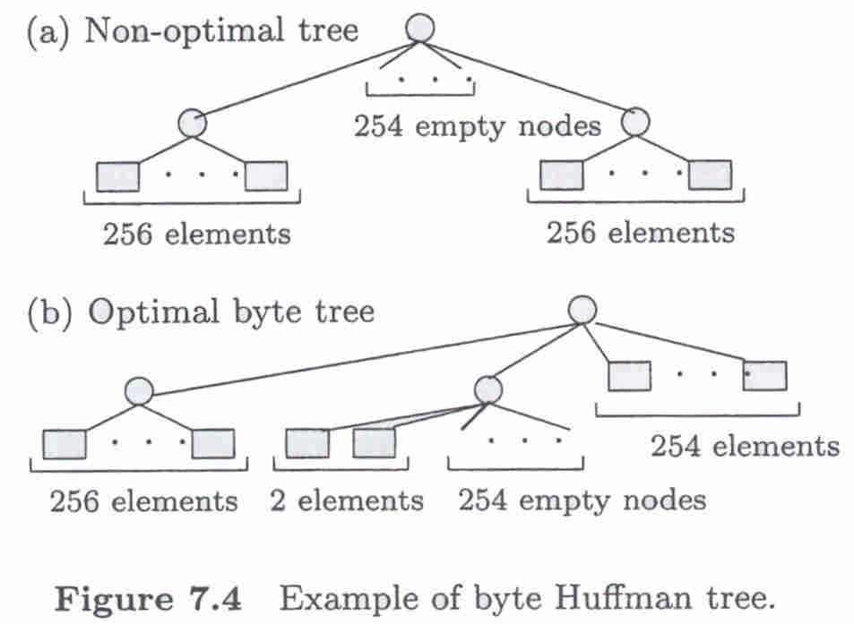

Slide 25
Dictionary Methods
Dictionary methods achieve compression by replacing groups of consecutive symbols (or phrases) with a pointer to an entry in a dictionary. Thus, the central decision in the design of a dictionary method is the selection of entries in the dictionary.
The choice of phrases can be made by static, semi-adaptive, or adaptive algorithms.
The simplest dictionary schemes use static dictionaries containing short phrases.
The main problem with static dictionary encoders is that the dictionary might be suitable for one text and unsuitable for another.

Slide 26
Contd…
The Ziv-Lempel type of adaptive dictionary scheme uses the idea of replacing strings of characters with a reference to a previous occurrence of the string.
This approach is effective because most characters can be coded as part of a string that has occurred earlier in the text.

Slide 27
Contd…
Adaptive dictionary methods present some disadvantages over the statistical word-based Huffman method.
First, they do not allow decoding to start in the middle of a compressed file.
Second, dictionary schemes are still popular for their speed and economy of memory, but the new results in statistical methods make them the method of choice in an IR environment.

Slide 28
Inverted File Compression
An inverted file is typically composed of (a) a vector containing all the distinct words in the text collection (which is called the vocabulary) (b) for each word in the vocabulary, a list of all documents in which that word occurs.
Inverted files are widely used to index large text files.
The size of an inverted file can be reduced by compressing the inverted lists

Slide 29
Contd…
One possible coding scheme for this case is the unary code, in Which an integer x is coded as (x-1) one bits followed by a zero bit, so the code for the integer 3 is 110. The second column of Table 7.1 shows unary codes for integers between 1 and 10.

Slide 30
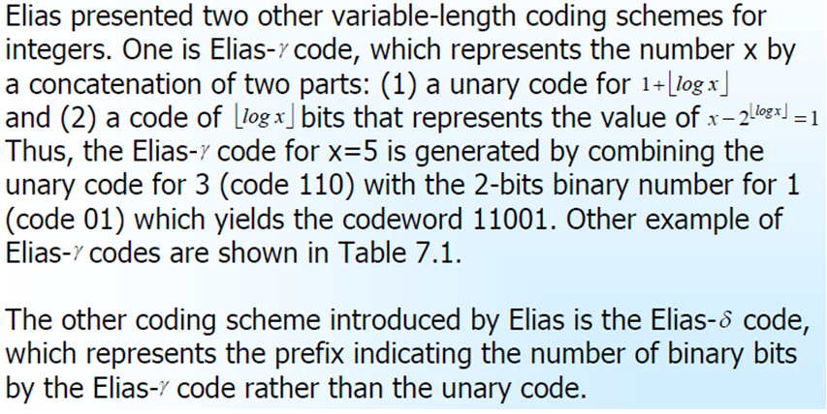

Slide 31
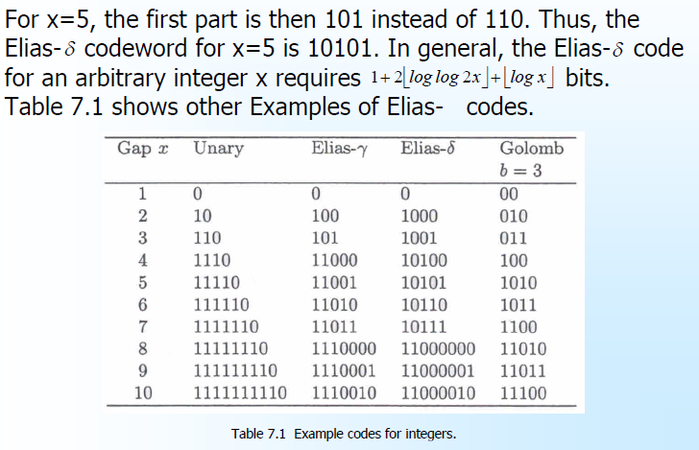

Slide 32

Golomb presented another run-length coding method for positive integer. The Golomb code is very effective when the probability distribution is geometric.
With inverted files, the likelihood of a gap being of size x can be computed as the probability of having x-1 non-occurrences (within consecutively numbered documents) of that particular word followed by one occurrence. If a word occurs within a document with a probability p, the probability of a gap of size x is then
which is the geometric distribution.

Slide 33
To operate with the Golomb compression method, it is first necessary to establish the parameter b for each term. For gap compression, an appropriate value is
Where, N is The total number of documents and ft is the number of documents that contain term t.

Slide 34
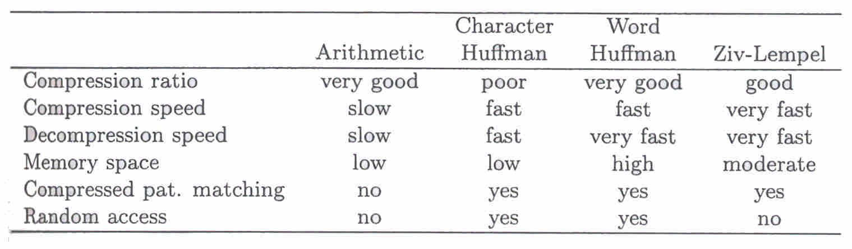
Comparing Text Compression Techniques

Slide 35
Indexing and Searching

Slide 36
Contents
Introduction
Inverted Files
Other Indices for Text
Boolean Queries
Sequential Searching
Pattern Matching
Structural Queries
Compression

Slide 37
Introduction
Option in searching for basic queries:
  Sequential/on-line text searching:
    Finding the occurrences of a pattern in a text when
    the text is not preprocessed.
    Good: when text is small (in MB) &
    when index overhead can’t be afforded.
  Indexed searching:
    Build data structure over the text (indices) to
    speedup the search.
    Good: when text is large or huge &
    the text is semi-static (not often updated).

Slide 38
Contd…
Main indexing techniques:
  Inverted files (Keyword-based search)
    best choice for most application.
  Suffix arrays/trees
    Faster for phrase searches but hard to build & maintain.
  Signature files.
    Was popular in the mid 1980 & inverted files take place.
For each techniques pay attention to:
  Search cost & Space overhead,
  construction cost & maintenance cost.

Slide 39
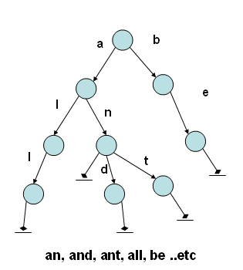
Contd…
Index should be built and stored in a data structure before
searching:
  Basic data structures: Sorted Arrays, Binary search tree, B-tree, hash table, Trie, Patricia tree .. etc.
Trie (from retrieval):
  Multi-way trees that store set of strings and
  able to retrieve them so fast depend on
  string length.
  Every edge of a tree is labeled with a letter.
  for storing strings over an alphabet
  Used in dictionaries (a, an, and...etc)

Slide 40
Inverted files
Definition:
  A word-oriented mechanism for indexing a text collection in order to speed up the searching task.
  Also called inverted index.
Composed of 2 elements:
  Vocabulary:
    Set of all different words in the text.
  Occurrences:
    for each word a list of all the text positions the word appears.
    the positions can refer to words or characters.

Slide 41
Contd…
A sample text and an inverted index built on it:
1 6 9 11 17 19 24 28 33 40 46 50 55 60
This is a text. A text has many words. Words are made from letters
text
Vocabulary
Occurrence
letters
made
many
text
words
60…
50…
28…
11, 19…
33, 40…
inverted index

Slide 42
Contd…
Required space
  The space required for the vocabulary is somewhat small.
  The occurrences demand much more space.
Block addressing
  The text is divided in blocks, and the occurrences point to the blocks where the word appears (instead of the exact position).
  Reduces space requirements:
    Pointers are smaller due to fewer blocks.
    Also word may occurs in the same block
  If the exact occurrence positions are required:
    Do online search over the qualifying blocks has to be performed

Slide 43
Contd…
The sample text split into four blocks
block 1 block 2 block3 block 4
This is a text. A text has many words. Words are made from letters
text
Vocabulary
Occurrence
letters
made
many
text
words
4…
4…
2…
1, 2…
3…
inverted index

Slide 44
Searching
General search steps
  Vocabulary search:
    The words and patterns present in the query are isolated and searched in the vocabulary.
  Retrieval of occurrences
    The lists of the occurrences of all the words found are retrieved.
  Manipulation of occurrences
    The occurrences are processed to solve phrases, proximity, or Boolean operations.
    If block addressing is used, it may be necessary to directly search the text to find the information missing from the occurrences.

Slide 45
Contd…
Singe word queries (Simple):
  Return the list of occurrence.
Context queries (Complex):
  Each element searched separately and a list is generated for each of them.
  Lists are traversed to find places where all the words appear in sequence for a phrase query or appear close enough for a proximity query.
In Block addressing watch block boundaries.

Slide 46
Construction
Constructing:
  Building and maintaining an inverted index is relatively low cost task.
  All vocabulary and stored in a data structure (Trie) and
  storing with each word a list of occurrences.
  Once constructed, it is written to disk in two files:
    Posting file: lists of occurrences are stored contiguously.
    Vocabulary file: Vocabulary is stored in lexicographical order
    with a pointer for each word to its list in the first file.
  Spliting the index into 2 files allows the vocabulary to be kept in memory to speed up the search.

Slide 47
Construction (2)
Construction step
  Read each word of the text
  Search the word in the trie.
    All the vocabulary known up to now is kept in a trie structure.
  If word is not found in the trie, it is added to the trie with its list of occurrence.
  If word is in the trie, the new position is added to the end of its list of occurrence.

Slide 48
Construction (3)
Building an inverted index for the sample text
1 6 9 11 17 19 24 28 33 40 46 50 55 60
This is a text. A text has many words. Words are made from letters
letters: 60
‘l’
‘d’
made: 50
‘m’
‘a’
‘t’
‘n’
many: 28
text: 11,19
‘w’
words: 33,40

Slide 49
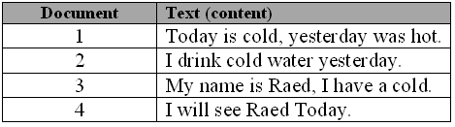
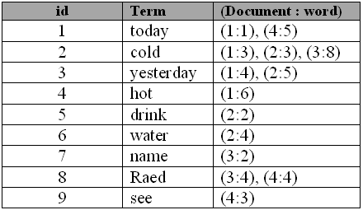
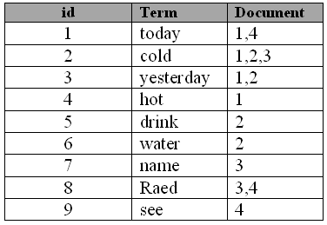
Example (2)

Slide 50
Inverted Files - construction
The procedure works as follows:
❑ Build and save partial indices I1, I2, …, In
❑ Merge Ij and Ij+1 into a single partial index Ij,j+1
  Merging indices mean that their sorted vocabularies are
merged, and if a term appears in both indices then the
respective lists should be merged (keeping the document order)
❑ Then indices Ij,j+1 and Ij+2,j+3 are merged into partial
index Ij,j+3, and so on and so forth until a single index is
obtained
❑ Several partial indices can be merged together at once

Slide 51
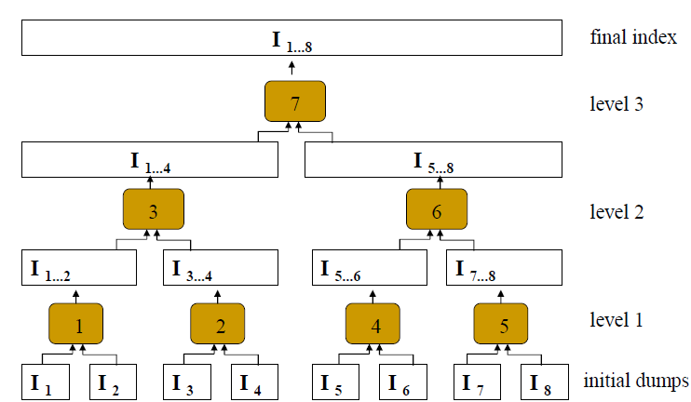

Slide 52
Other indices for text
Suffix trees and suffix arrays
Signature file

Slide 53
Suffix Trees and Suffix Arrays
Suffix
  Each position in the text is considered as a text suffix.
    A string that start from that text position to the end to the text
Both:
  They answer efficiently more complex queries.
  Costly construction process
  The text must be readily available at query time.
  The results are not delivered in text position order.

Slide 54
Suffix tree (1)
Index points of interest:
  selected form the text, which point to the beginning of the text
  positions which will be retrievable.
  each position is considered as a text suffix
  each suffix is uniquely identified by its position
structure
  Trie data structure built over all the suffixes of the text
    The pointers to the suffixes are stored at the leaf nodes
    This trie is compacted into a Patricia tree (compressing unary paths).
Searching
  Many basic patterns such as words, prefixes, and phrases can be searched by a simple trie search.

Slide 55
Suffix tree (2)
The suffix trie and suffix tree for the sample text
text. A text has many words. Words are made from letters.
many words. Words are made from letters.
…………
made from letters.
letters.
Suffixes
Index point of interest
1 6 9 11 17 19 24 28 33 40 46 50 55 60
This is a text. A text has many words. Words are made from letters
suffix trie
suffix tree (PAT)
60
60
‘l’
‘d’
50
‘l’
‘d’
50
‘m’
‘m’
‘a’
1
3
‘n’
‘n’
28
‘t’
28
‘t’
‘’
‘e’
‘x’
‘t’
‘’
19
19
5
‘.’
11
‘.’
11
‘w’
‘’
40
‘w’
‘o’
‘r’
‘d’
‘s’
‘’
40
‘.’
6
33
‘.’
33

Slide 56
Suffix arrays (1)
Structure
  Suffix arrays are space efficient implementation of suffix trees.
  Simply an array containing all the pointers to the text suffixes listed in lexicographical order.
  Supra-indices:
    If the suffix array is large, this binary search can perform poorly because of the number of random disk accesses.
    Suffix arrays are designed to allow binary searches done by comparing the contents of each pointer.
    To remedy this situation, the use of supra-indices over the suffix array has been proposed.

Slide 57
Suffix arrays (2)
Example
1 6 9 11 17 19 24 28 33 40 46 50 55 60
This is a text. A text has many words. Words are made from letters
suffix tree
60
60 | 50 | 28 | 19 | 11 | 40 | 33
Suffix Array
50
1
3
28
19
5
lett |  | text |  | word
Supra-Index
11
40
6
33
60 | 50 | 28 | 19 | 11 | 40 | 33
Suffix Array

Slide 58
Signature files (1)
Definition
  Word-oriented index structure based on hashing.
  Use liner search.
  Suitable for not very large texts.
Structure
  Based on a Hash function that maps words to bit masks.
  The text is divided in blocks.
    Bit mask of block is obtained by bitwise ORing the signatures of all the words in the text block.
    Word not found, if no match between all 1 bits in the query mask and the block mask.

Slide 59
Signature files (2)
Example:
block 1 block 2 block3 block 4
This is a text. A text has many words. Words are made from letters
000101 |  | 110101 |  | 100100 |  | 101101
Text signature
h(text) = 000101
h(many) = 110000
h(words) = 100100
h(made) = 001100
h(letters) = 100001
Signature function

Slide 60
Signature files (3)
False drop Problem
  The corresponding bits are set even though the word is not there!
  The design should insure that the probability of false drop is low.
    Also the Signature file should be as short as possible.
  Enhance the hashing function to minimize the error probability.

Slide 61
Signature files (4)
Searching
  If searching a single word, Hash word to a bit mask W.
  If searching phrases and reasonable proximity queries,
    Hash words in query to a bit mask.
    Bitwise OR of all the query masks to a bit mask W.
  Compare W to the bit masks B_{i} of all the text blocks.
    If all the bits set in W are also in B_{i}, then text block may contain the word.
  For all candidate text blocks, an online traversal must be performed to verify if the query is actually there.
Construction
  Cut the text in blocks.
  Generate an entry of the signature file for each block.
    This entry is the bitwise OR of the signatures of all the words in the block.

Slide 62
Boolean queries
Its manipulations algorithms
  Used to operate on sets of results.
  Example: a OR (b AND c)
Search phase
  Determine which documents classify
  Determines the relevance of the classifying documents so as to present them appropriately to the user.
  Retrieves the exact positions of the matches to highlight them in those documents that the user actually wants to see.

Slide 63
Sequential searching
  Used for text searching when no data structure has been built on the text.
  The problem of exact string matching is :
    Given a short pattern P of length m and long T of length n, find all the text position where the pattern occurs.

Slide 64
Sequential searching
Brute force
Knuth-Morris-Pratt
Boyer-Moore Family
Shift-Or

Slide 65
Brute Force
Brute Force algorithm (BF)
  The simplest possible one.
  It consists of merely trying all possible pattern positions in the text. For each such position, it verifies whether the pattern matches at that position.
  Does not need any pattern preprocessing.
  Many algorithms use a modification of this scheme.
  Left to right search.

Slide 66
Brute Force example
a | b | r | a | c | a | b | r | a | c | a | d | a | b | r | a
a | b | r | a | c | a | d | a | b | r | a

Slide 67
Knuth-Morris-Pratt(1)
Reuse information from previous checks
  When the window has to be shifted, there is a prefix of the pattern that matched the text.
  The algorithm takes advantage of this information to avoid trying window positions which can be deduced not to match.
  left to right scan like the Brute Force algorithm.

Slide 68
Knuth-Morris-Pratt(2)
Next table
  The next table at position j says which is the longest proper prefix of P_{1..j-1} which is also a suffix and the characters following prefix and suffix are different.
    j-next[j]+1 window positions can be safely skipped if the characters up to j-1 matched, and the j-th did not.

Slide 69
Knuth-Morris-Pratt(3)
Next table for ‘abracadabra’
[next function]
next | 0 0 0 0 1 0 1 0 0 0 0 4
search pattern
a
b
r
a
c
a
d
a
b
r
a

Slide 70
Knuth-Morris-Pratt(4)
Searching ‘abracadabra’
[search example]
a | b | r | a | c | a | b | r | a | c | a | d | a | b | r | a
a | b | r | a | c | a | d
a | b | r | a | c | a | d | a | b | r | a

Slide 71
Boyer-Moore Family(1)
BM algorithm
  Based on the fact that the check inside the window can proceed backwards.
    When a match or mismatch is determined, a suffix of the pattern has been compared and found equal to the text in the window.

Slide 72
Boyer-Moore Family(2)
BM example
  Searching ‘date’
p=’’date’’
  index[d]=0
  index[a]=1
  index[t]=2
  index[e]=3
  index[anything else] = -1

Slide 73
Boyer-Moore Family(3)
BM example
  Searching ‘date’
T="some date"
P="date”
** m<>t.. index[m]=-1 so
move so -1th posn of P below m
T="some date"
"date"
* a<>e.. index[a]=1 so
move so char 1 of P below a.
T="some date"
“date”
****

Slide 74
Shift-Or(1)
  The basic idea of the Shift-Or (SO) algorithm, is to represent the state of the search as a number, and each search step costs a small number of arithmetic and logical operations.
  Efficient if the pattern length is no longer than the memory-word size of the machine w.( w is 32,64).

Slide 75
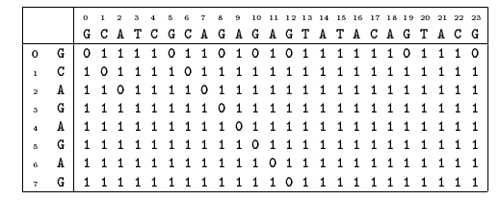
Shift-Or(2)
SO example
  Searching ‘GCAGAGAG’.
  p has been found at position 12-8+1=5

